Slide 1
IoT Based Home Automation System
Submitted in the partial fulfillment for the award of the degree of
BACHELOR OF ENGINEERING
IN
B.E – CSE (Hons.) Internet of Things
Submitted by:
PRABAL MANHAS 20BCS4513
Under the Supervision of:
Ms. Rashi Sahay
Department of AIT-CSE
DISCOVER . LEARN . EMPOWER

Slide 2
Outline
Introduction to Project
Problem Formulation
Objectives of the work
Methodology used
Results and Outputs
Conclusion
Future Scope
References

Slide 3
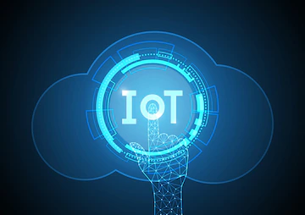
Introduction to Project
The advent of IoT brought major changes in the industry standards, today we can get our tasks done easily without physical interaction just with the help of our devices connected to internet ranging from ordering, clothes etc. online.
Our project objective is to design an IoT based home automation system, which can ease our daily tasks and enhance the productivity.

Slide 4
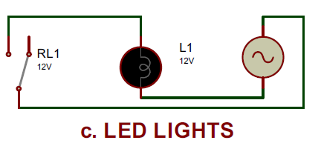
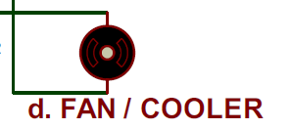
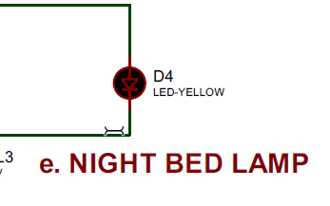
Introduction to Project (contd.)
In this project we are making use of some tools such as Proteus Simulator, Bluetooth HC05 Modules, Transistors, LED’s, DC Motors etc.
The main purpose is to remotely controlling all our home appliances and electronic items such as Lights, Air Conditioner, Fans etc. using voice commands via an Android Application developed by us using MIT App Inventor.

Slide 5
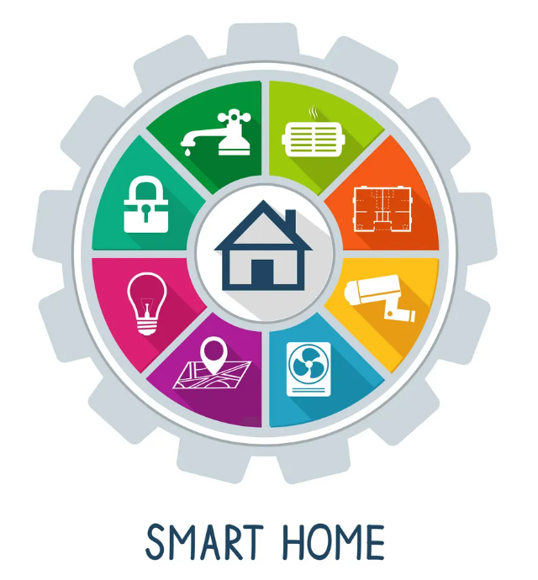
Problem Formulation
By using IoT based home automation, it will be easier for us to manage all the electrical appliances and devices present in home and it will also reducing the energy consumption thus promoting sustainable development.
By using our project people belonging to all age groups can remotely control the devices easily without much prior technical knowledge by just giving voice commands via application developed by us.

Slide 6
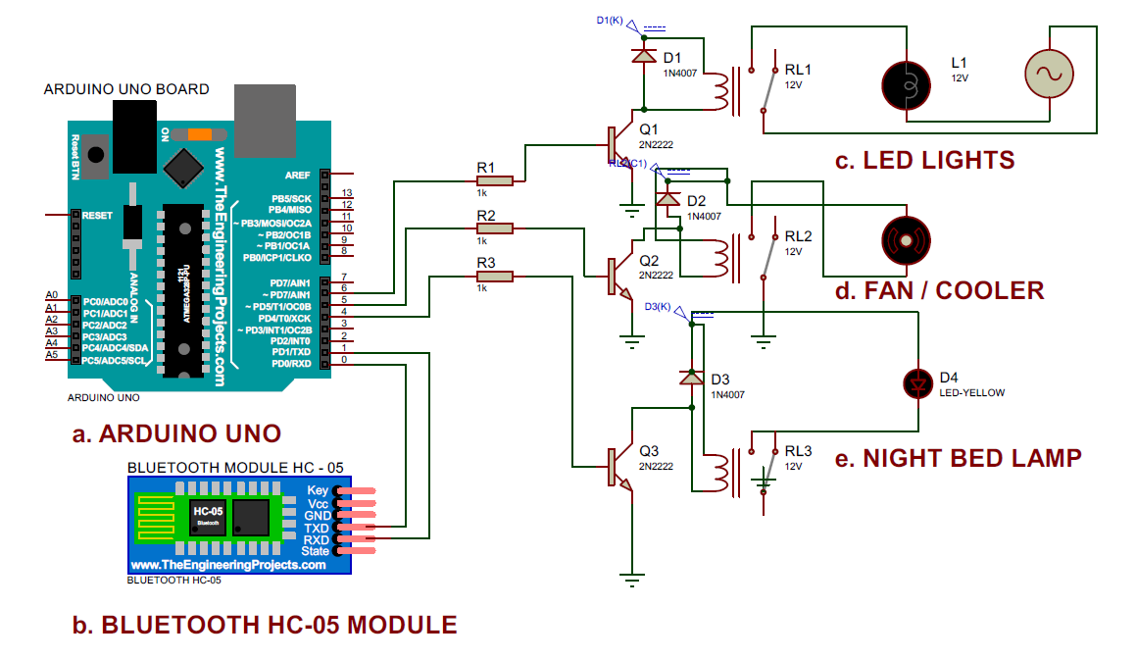
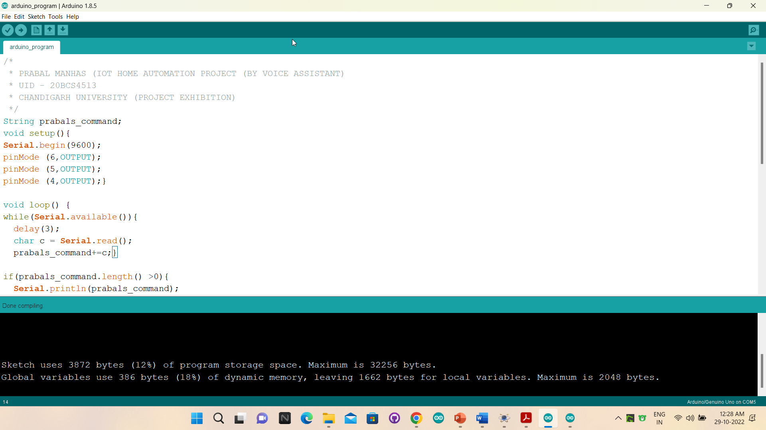
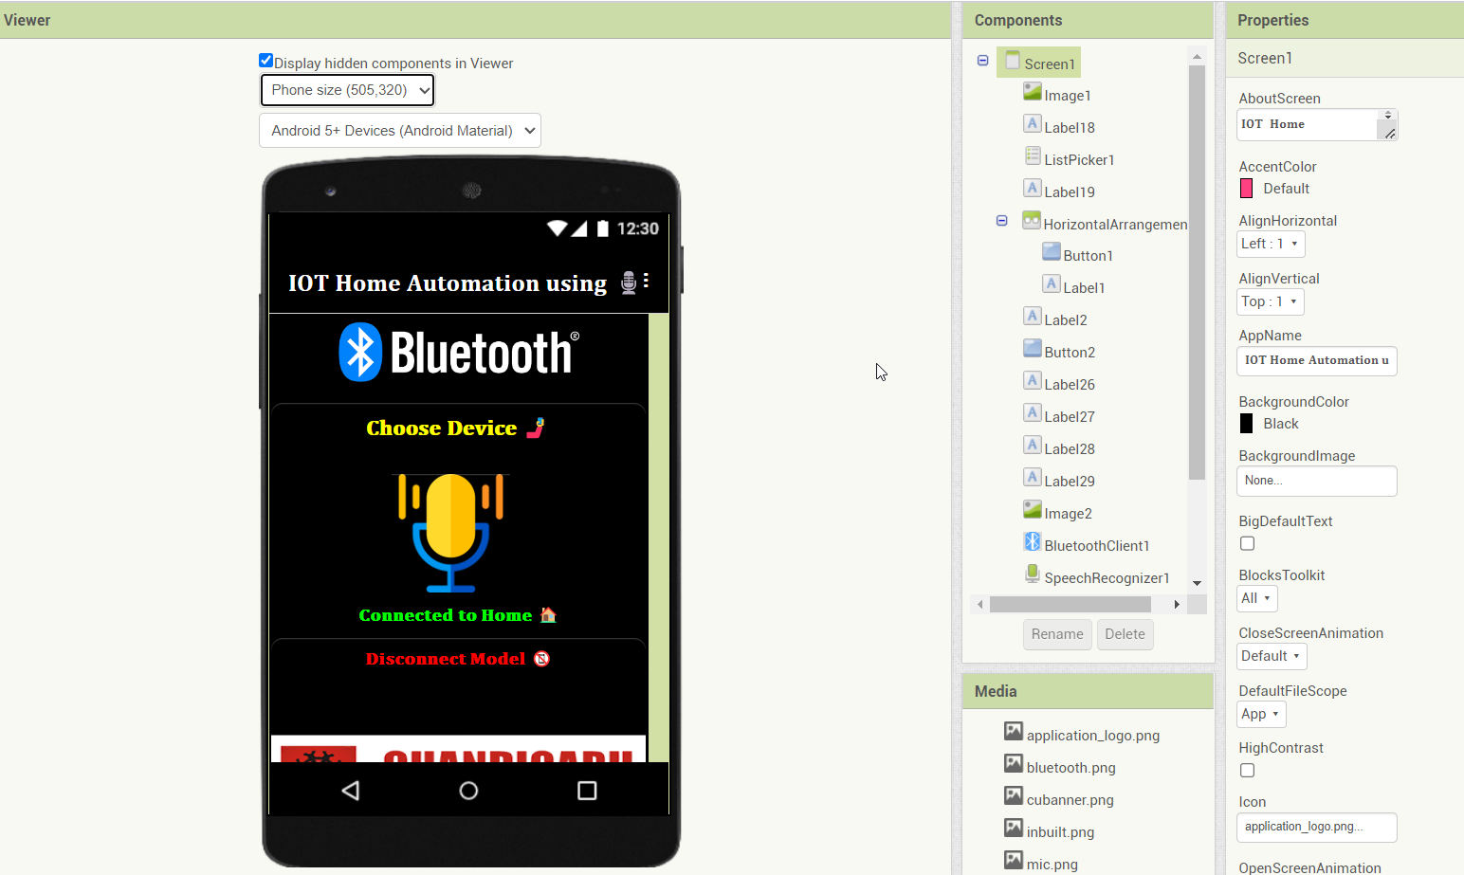
Objectives of the Work
Creating a Home Automation System consisting of several home appliances using Proteus
Programming the Arduino accordingly with some predefined voice assistant commands and actions to perform accordingly
Developing our own android application for remotely controlling all the appliances by just sending the voice commands

Slide 7
Methodology used
Proteus Designing:
Making use of some home appliances such as LED’s, Night Lamps, DC Motor Fans & AC Current Source in order to build our home automation ecosystem on Proteus Simulator.
Also using the Arduino Uno Module, Bluetooth HC-05 appliance, transistors, resistors and relays etc.

Slide 8
Methodology used
Proteus Designing:

Slide 9
Methodology used
Programming our voice assistant with Arduino
Programming our voice assistant accordingly with the help of Arduino UNO IDE and declaring the predefined voice commands in our programming and the action to perform accordingly on its execution.
Making use of some personalized commands such as:
Turning OFF all the LED’s on the voice command input = “Good Morning”
Turning ON all the appliance such as Lights, Fans, Bed Lamps on the input = “OK I am back home”
Turning OFF all the appliances on input = “I am leaving home”
Switching ON the night lamps on: “good evening” etc. to get personalized user experience.

Slide 10
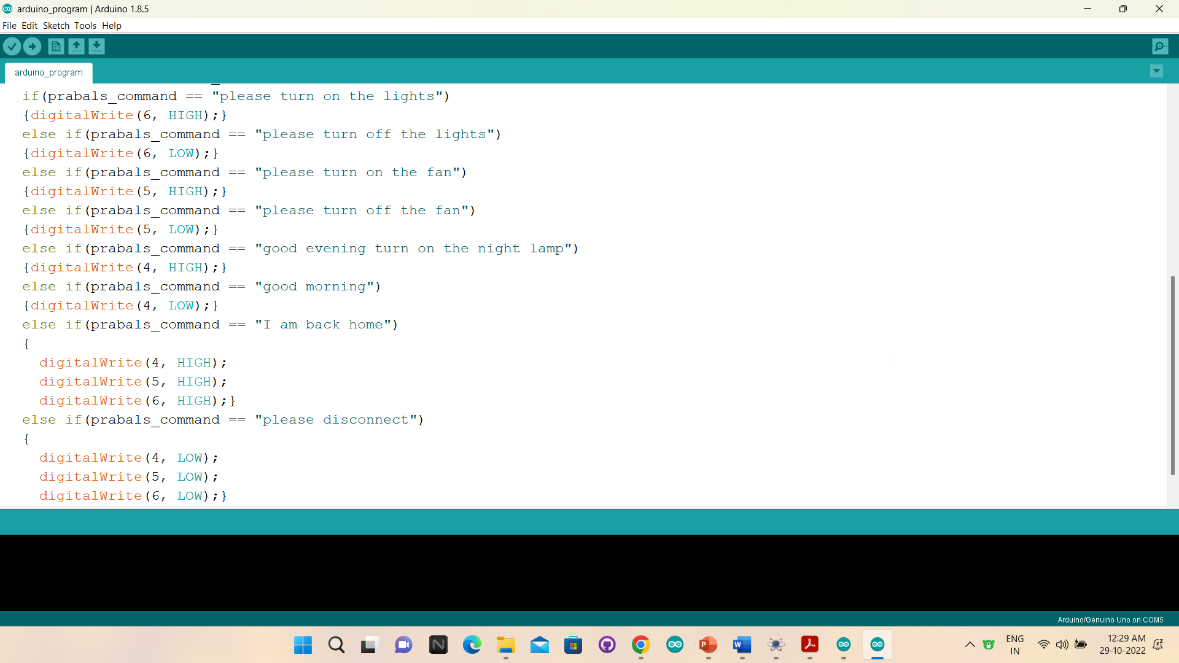
Methodology used
Programming our voice assistant with Arduino

Slide 11
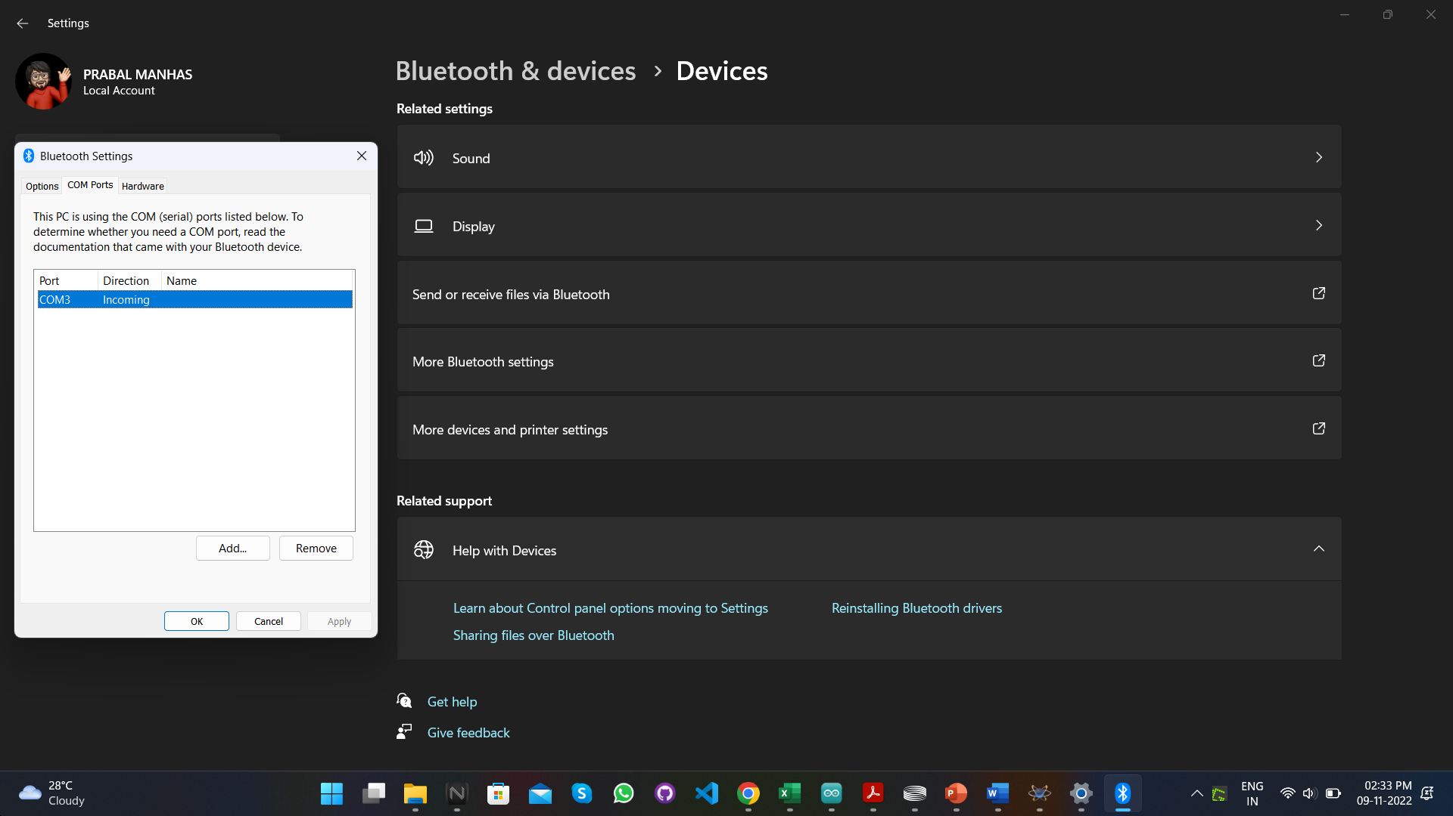
Methodology used
Configuring Bluetooth COM Port Windows Setting in order to communication with our Android Device for Remote Access

Slide 12
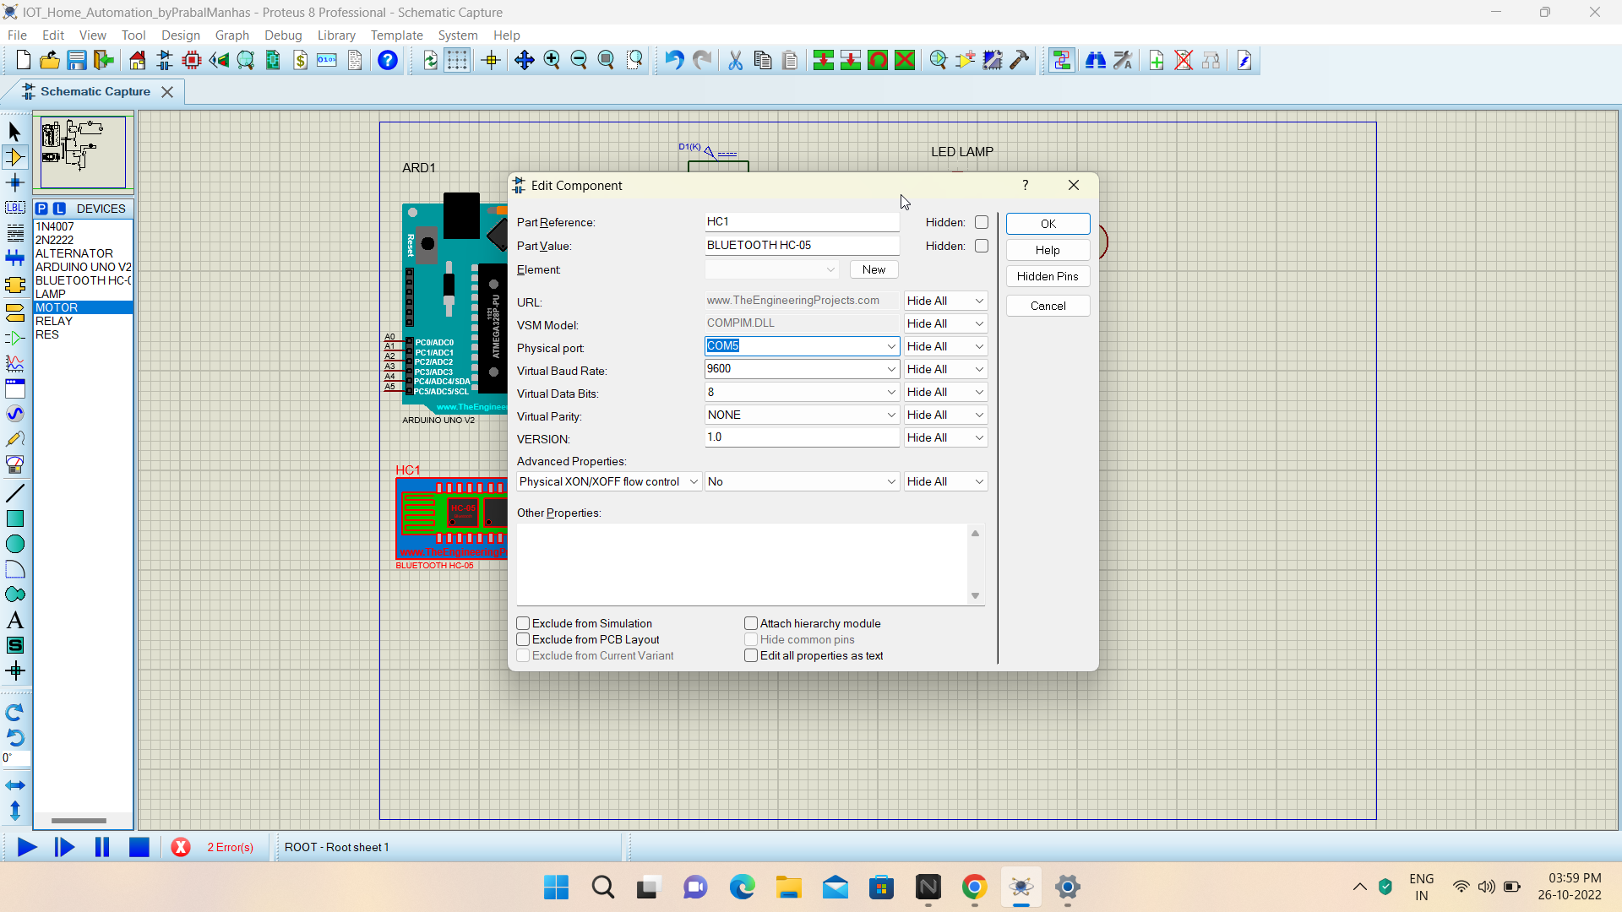
Methodology used
Configuring Bluetooth COM Port Windows Setting in order to communication with our Android Device for Remote Access

Slide 13
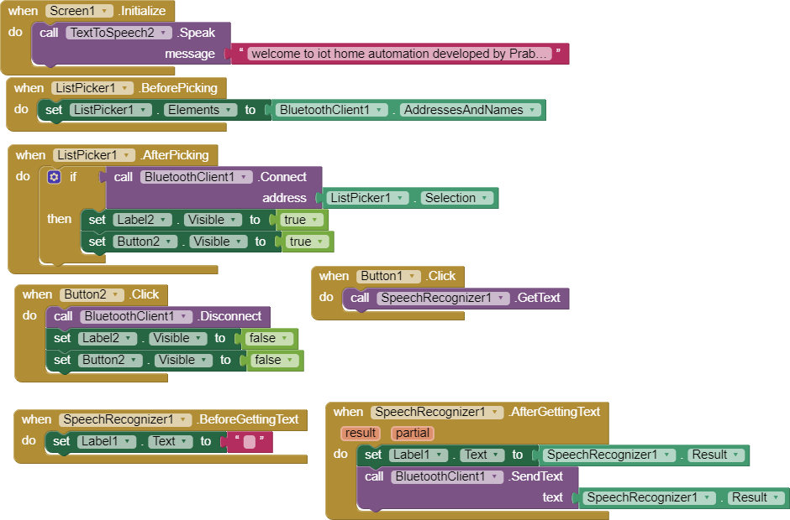
Methodology used
Developing our own Android Application: Backend

Slide 14
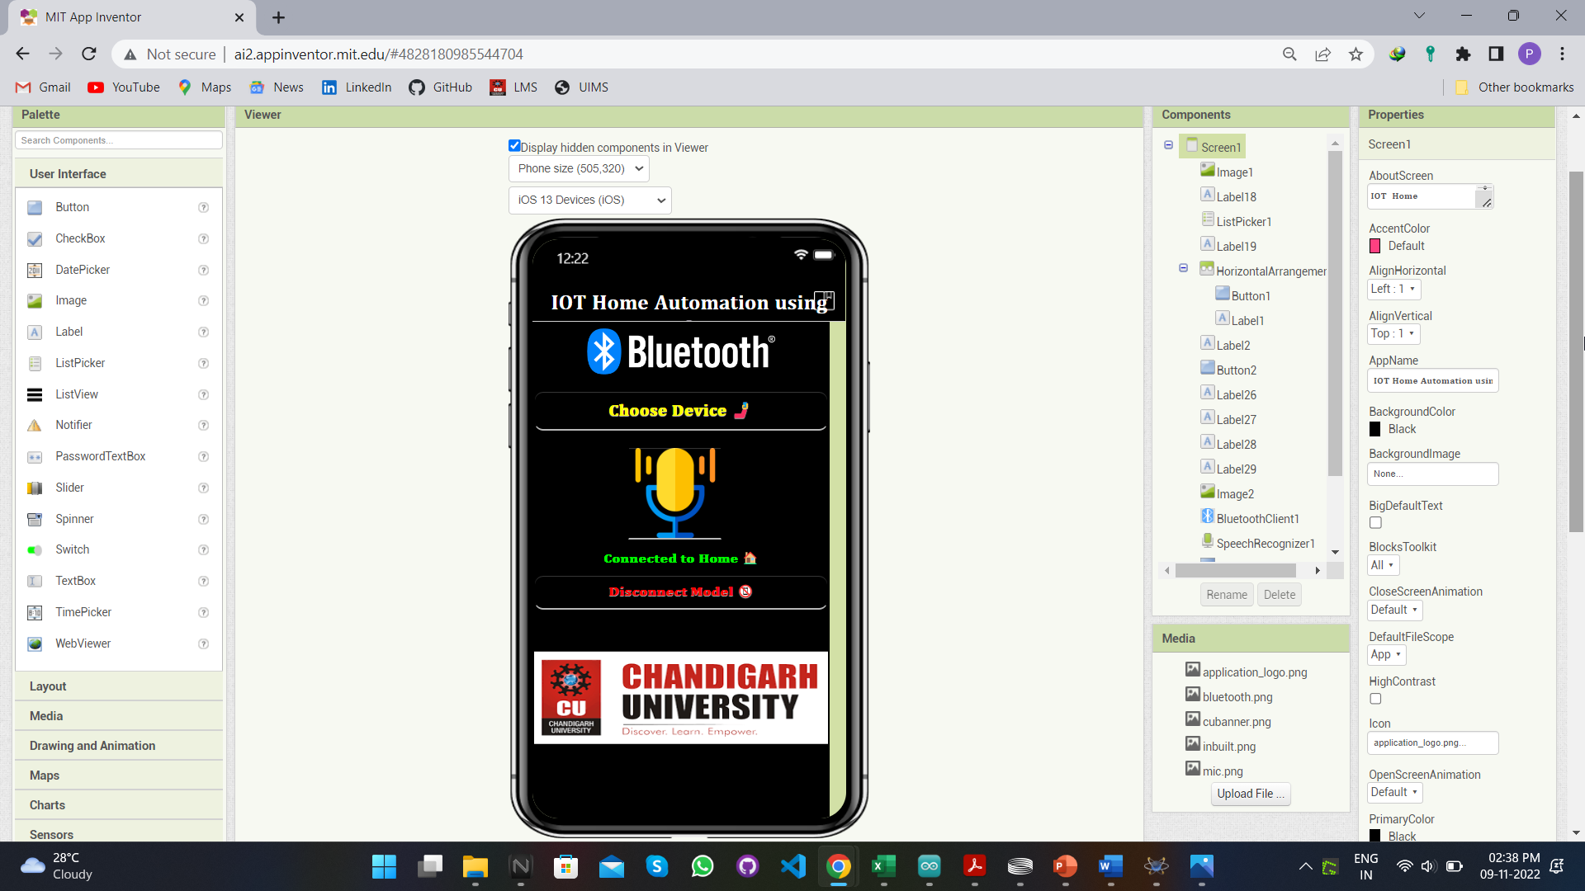
Methodology used
Developing our own Android Application: Frontend

Slide 15
Results and Outputs
Finally we connected our designed home automation system with Arduino using the .hex file.
Further configured the Bluetooth COM port on my pc i.e. COM3 and configured the same in the Bluetooth HC-05 module present in proteus.
Last but not the least, we executed the project and controlled all the home appliances by just giving voice commands through our application.

Slide 16
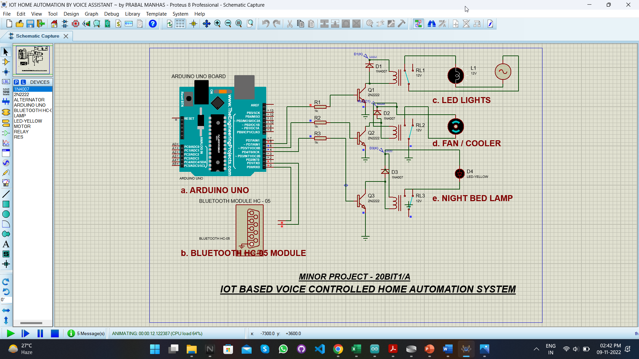
Results and Outputs
LED TURNED ON

Slide 17
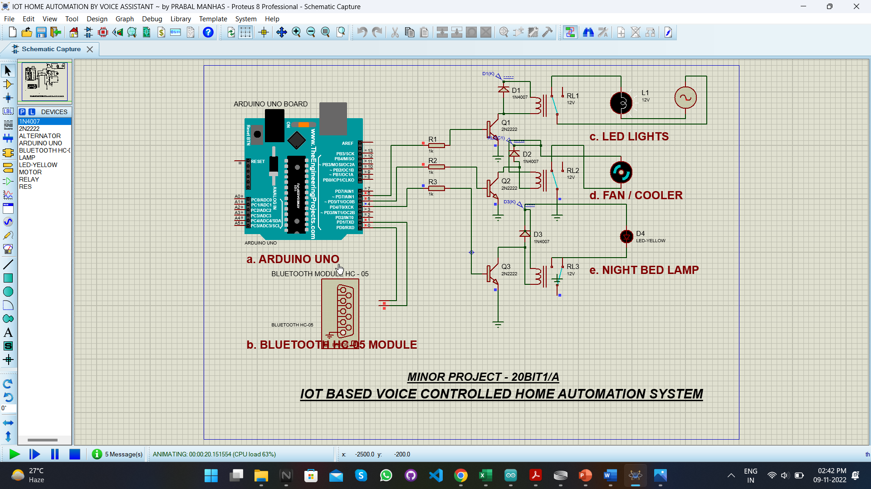
Results and Outputs
FAN TURNED ON

Slide 18
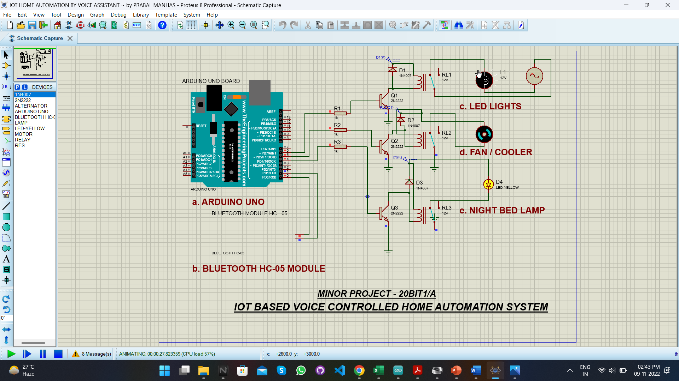
Results and Outputs
ALL APPLIANCES TURNED ON ~ on the command “I am back home”

Slide 19
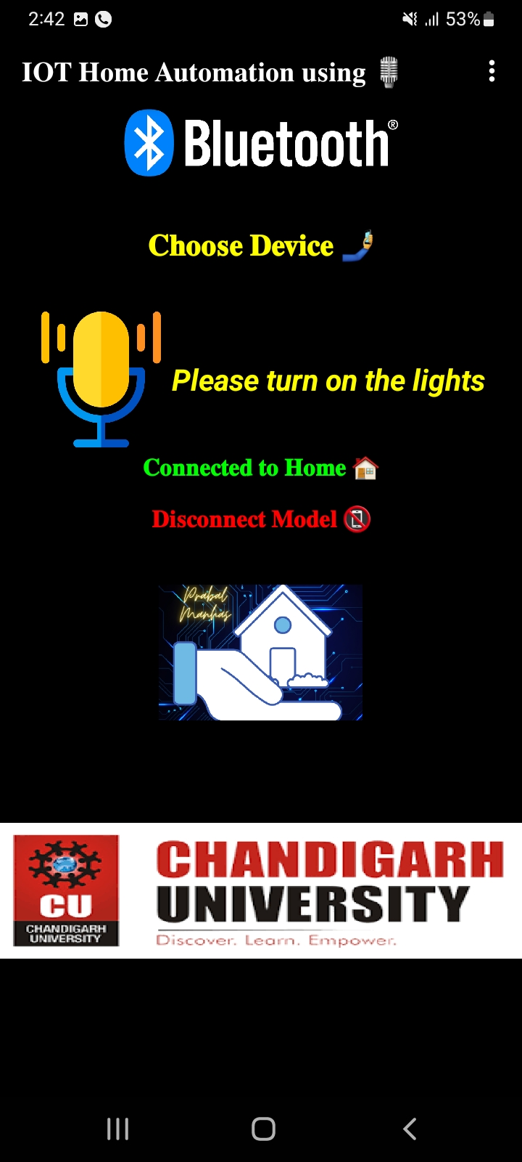
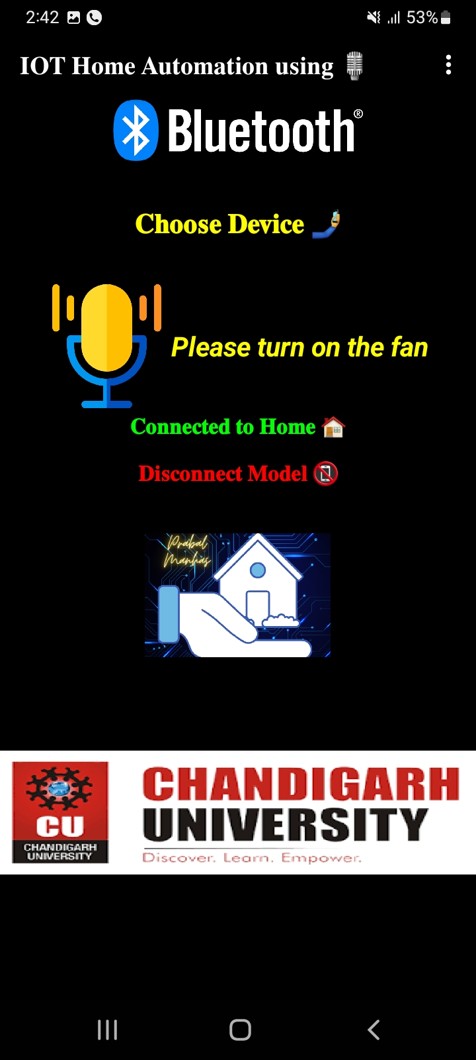
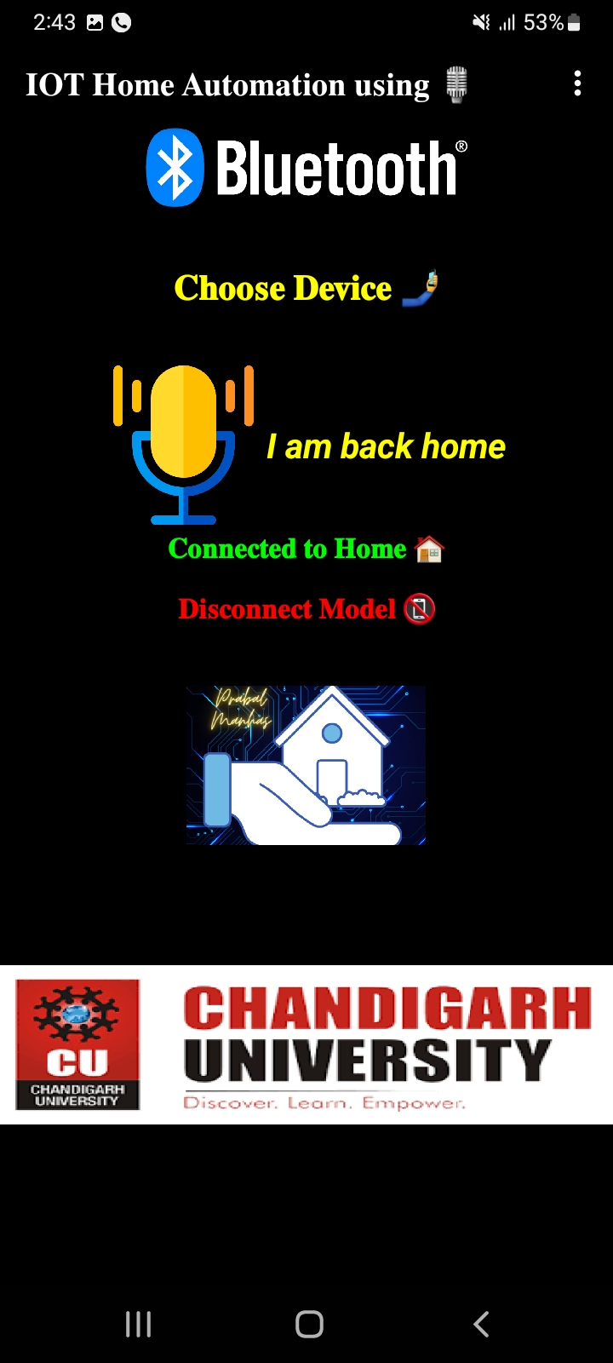
Results and Outputs
Android App – Voice Inputs

Slide 20
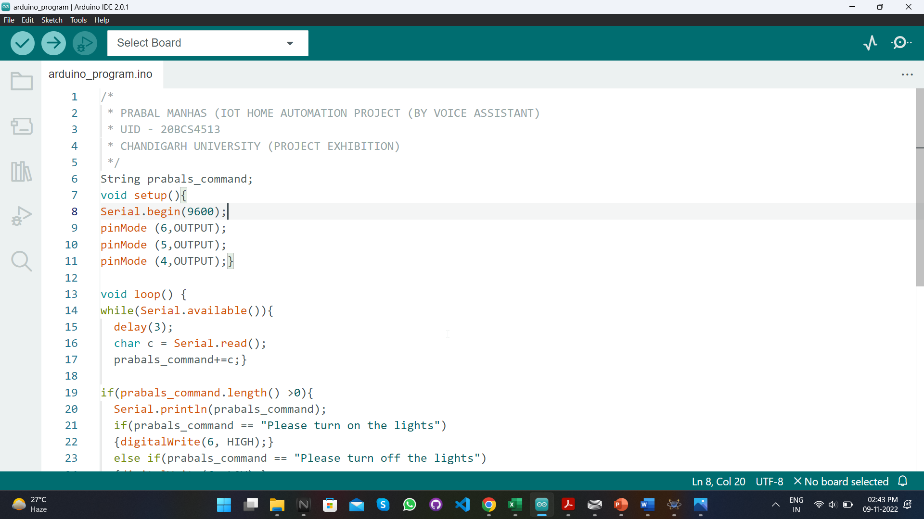
Results and Outputs
Arduino Commands for Voice Assistant

Slide 21
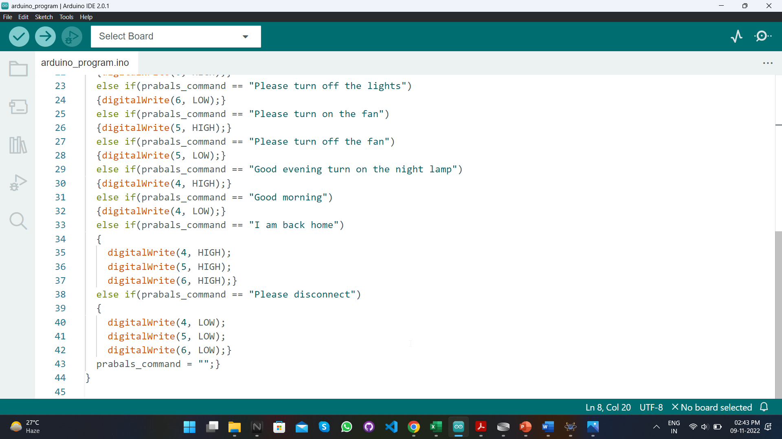
Results and Outputs
Arduino Commands for Voice Assistant

Slide 22
Conclusion
Our designed project “IoT Based Home Automation System” will help in transforming the IoT industry by making it easier for the people to control the appliances and sync the devices on a network.
Also it will help in preserving our energy resources and reduce the energy consumption thereby promoting sustainable development.
Will reduce the manual work load i.e. checking all the devices turned on in home and then manually turning them off.

Slide 23
Future Scope
The advent of IoT brought major changes in the industry standards, today we can get our tasks done easily without physical interaction just with the help of our devices connected to internet ranging from ordering, clothes etc. online.
Our project objective is to design an IoT based home automation system, which can ease our daily tasks and enhance the productivity. In this project we are making use of some tools such as Proteus Simulator, Bluetooth HC05 Modules, Transistors, LED’s, DC Motors etc.
The main purpose is to remotely controlling all our home appliances and electronic items such as Lights, Air Conditioner, Fans etc. using voice commands via an Android Application developed by us using MIT App Inventor.

Slide 24
References
IEEE Research Paper - https://ieeexplore.ieee.org/document/8844945
Bluetooth HC-05 Module - https://www.theengineeringprojects.com/2016/03/bluetooth-library-for-proteus.html
MIT App Inventor - https://appinventor.mit.edu/
Canva Graphics - https://www.canva.com/templates/
Arduino - https://www.arduino.cc/
Proteus Simulator - https://www.labcenter.com/downloads/

Slide 25
References
Vector Graphics - https://www.freepik.com/
Medium Home Automation Article - https://medium.com/@WolfgangPfretzschner/home-automation-199afcaa1d2d

